Slide 1
Unit - 5 VISUALIZING DATA: BAR CHARTS, LINE CHARTS, SCATTERPLOTS

Slide 2
Working with data
pip install pandas
Reading Excel File using Pandas in Python
Installing and Importing Pandas
Reading multiple Excel sheets using Pandas
Application of different Pandas functions
Installating Pandas
To install Pandas in Python, we can use the following command in the command prompt:
pip install pandas

Slide 3
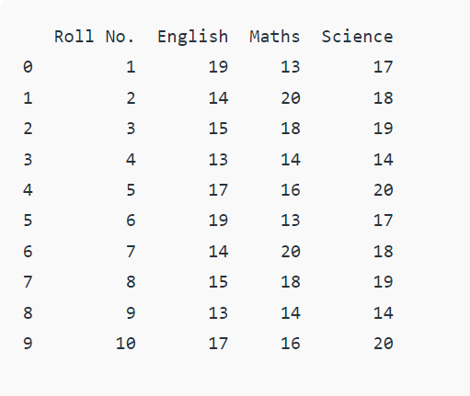
Reading Files using pandas
import pandas as pd
df = pd.read_excel('Example.xlsx')
print(df)

Slide 4
Python provides inbuilt functions for creating, writing, and reading files.
There are two types of files that can be handled in python, normal text files and binary files (written in binary language, 0s, and 1s).
Text files: In this type of file, Each line of text is terminated with a special character called EOL (End of Line), which is the new line character (‘\n’) in python by default.
Binary files: In this type of file, there is no terminator for a line, and the data is stored after converting it into machine-understandable binary language.
# Open function to open the file "MyFile1.txt"
# (same directory) in append mode and
file1 = open("MyFile.txt","a")
# store its reference in the variable file1
# and "MyFile2.txt" in D:\Text in file2
file2 = open(r"MyFile.txt","w+")

Slide 5
# a file named “myfile", will be opened with the reading mode.
file = open(‘myfile.txt', 'r')
# This will print every line one by one in the file
for each in file:
print (each)

Slide 6
Data Cleaning
Data cleaning is one of the important parts of machine learning.
It plays a significant part in building a model.
It surely isn’t the fanciest part of machine learning and at the same time, there aren’t any hidden tricks or secrets to uncover.
However, the success or failure of a project relies on proper data cleaning.
Professional data scientists usually invest a very large portion of their time in this step because of the belief that “Better data beats fancier algorithms”.

Slide 7
What Is Data Munging?
Data munging is the process of cleaning and transforming data prior to use or analysis.
Without the right tools, this process can be manual, time-consuming, and error-prone.
Many organizations use tools such as Excel for data munging.
While Excel can be used for the data munging process, it lacks the sophistication and automation to make the process efficient.
In most organizations, 80% of the time spent on data analytics is allocated to data munging, where IT manually cleans the data to pass over to business users who perform analytics.
Data munging can be a time consuming and disjointed process that stands in the way of extracting true value and potential from data.

Slide 8
Why Is Data Munging Important?
Data’s messy, and before it can be used for analysis and driving business objectives, it needs a little tidying up.
Data munging helps remove errors and missing data so that data can be used for analysis.
Here’s a look at some of the more important roles data munging plays in data management.
Data Preparation, Integration, and Quality
Data Enrichments and Transformation
Data Analysis
Time and Resource Efficiency

Slide 9
What is data manipulation?
Data manipulation is the process of organizing or arranging data in order to make it easier to interpret.
Data manipulation typically requires the use of a type of database language called data manipulation language (DML).
DML is a type of coding language that allows you to reorganize data by modifying it within its database program.

Slide 10
Common operations used for data manipulation include:
Aggregation
Classification
Mathematical formulas
Regression analysis
Row and column filtering
String concatenation

Slide 11
Examples of data manipulation
Data manipulation can be used to:
Arrange data alphabetically or by date to find individual entries
Manage web server logs where website owners can monitor most-viewed web pages and traffic sources
Create forecasts of stock market trends
Assess the expense of products, pricing patterns or future tax obligations
View online information in a more useful way to users based on code in a user-defined software program

Slide 12
Data Rescaling
Your preprocessed data may contain attributes with a mixtures of scales for various quantities such as dollars, kilograms and sales volume.
Many machine learning methods expect or are more effective if the data attributes have the same scale. Two popular data scaling methods are normalization and standardization.
Normalization refers to rescaling real valued numeric attributes into the range 0 and 1.
It is useful to scale the input attributes for a model that relies on the magnitude of values, such as distance measures used in k-nearest neighbors and in the preparation of coefficients in regression.

